Slide 1

Natural gas

Slide 2
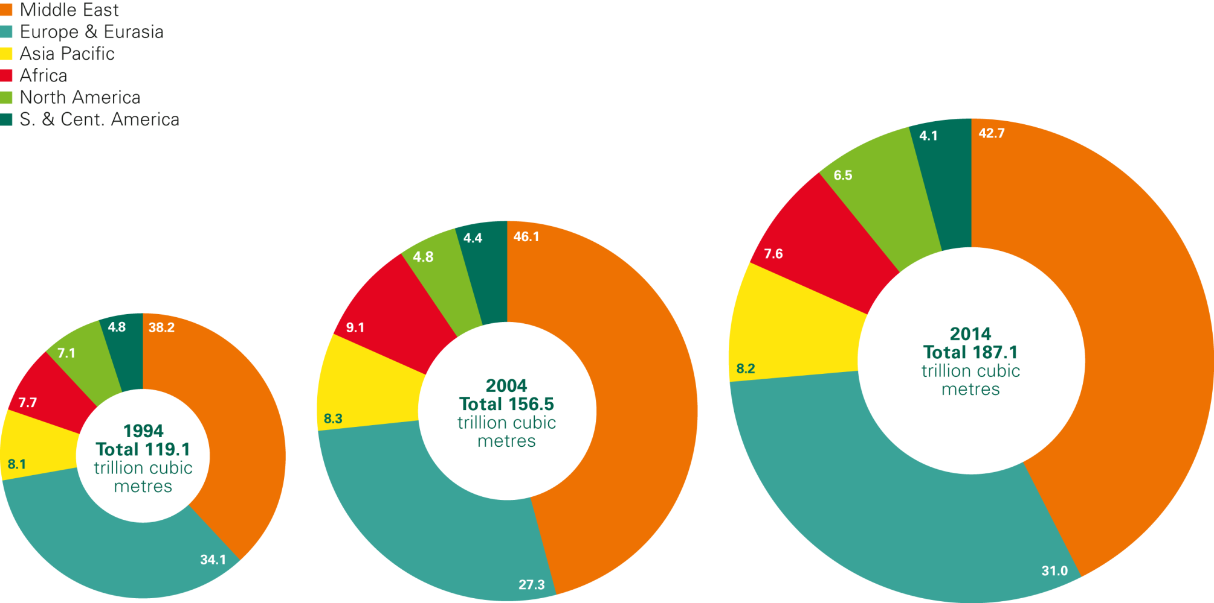
Distribution of proved gas reserves: 1994, 2004 and 2014
Percentage

Slide 3
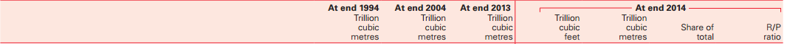
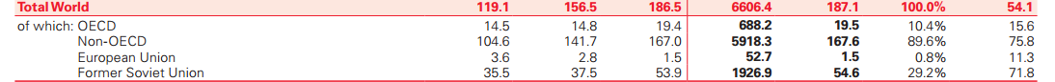
Gas reserves-to-production (R/P) ratios Years

Slide 4
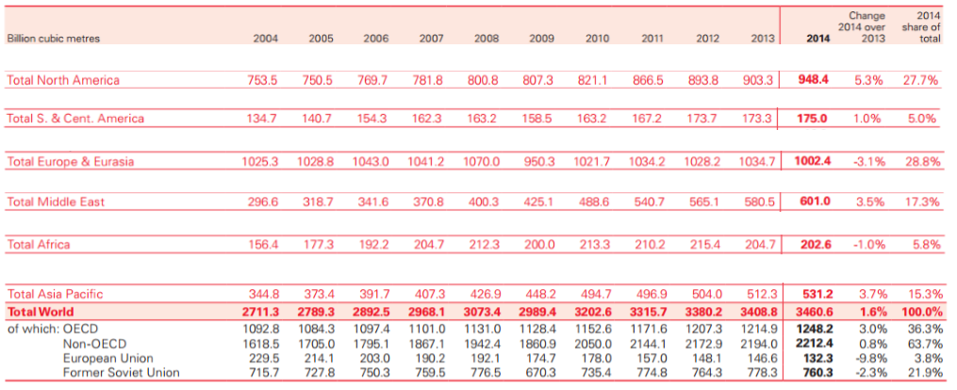
Production

Slide 5
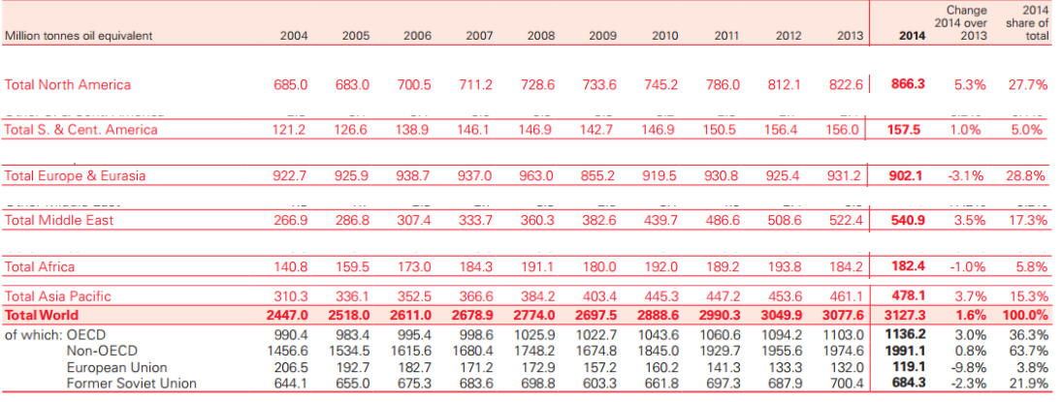
Production

Slide 6
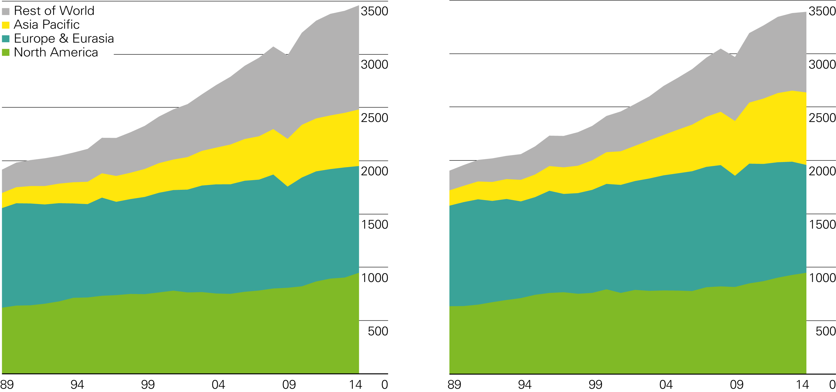
Gas production/consumption by region
Billion cubic metres
Production by region
Consumption by region

Slide 7
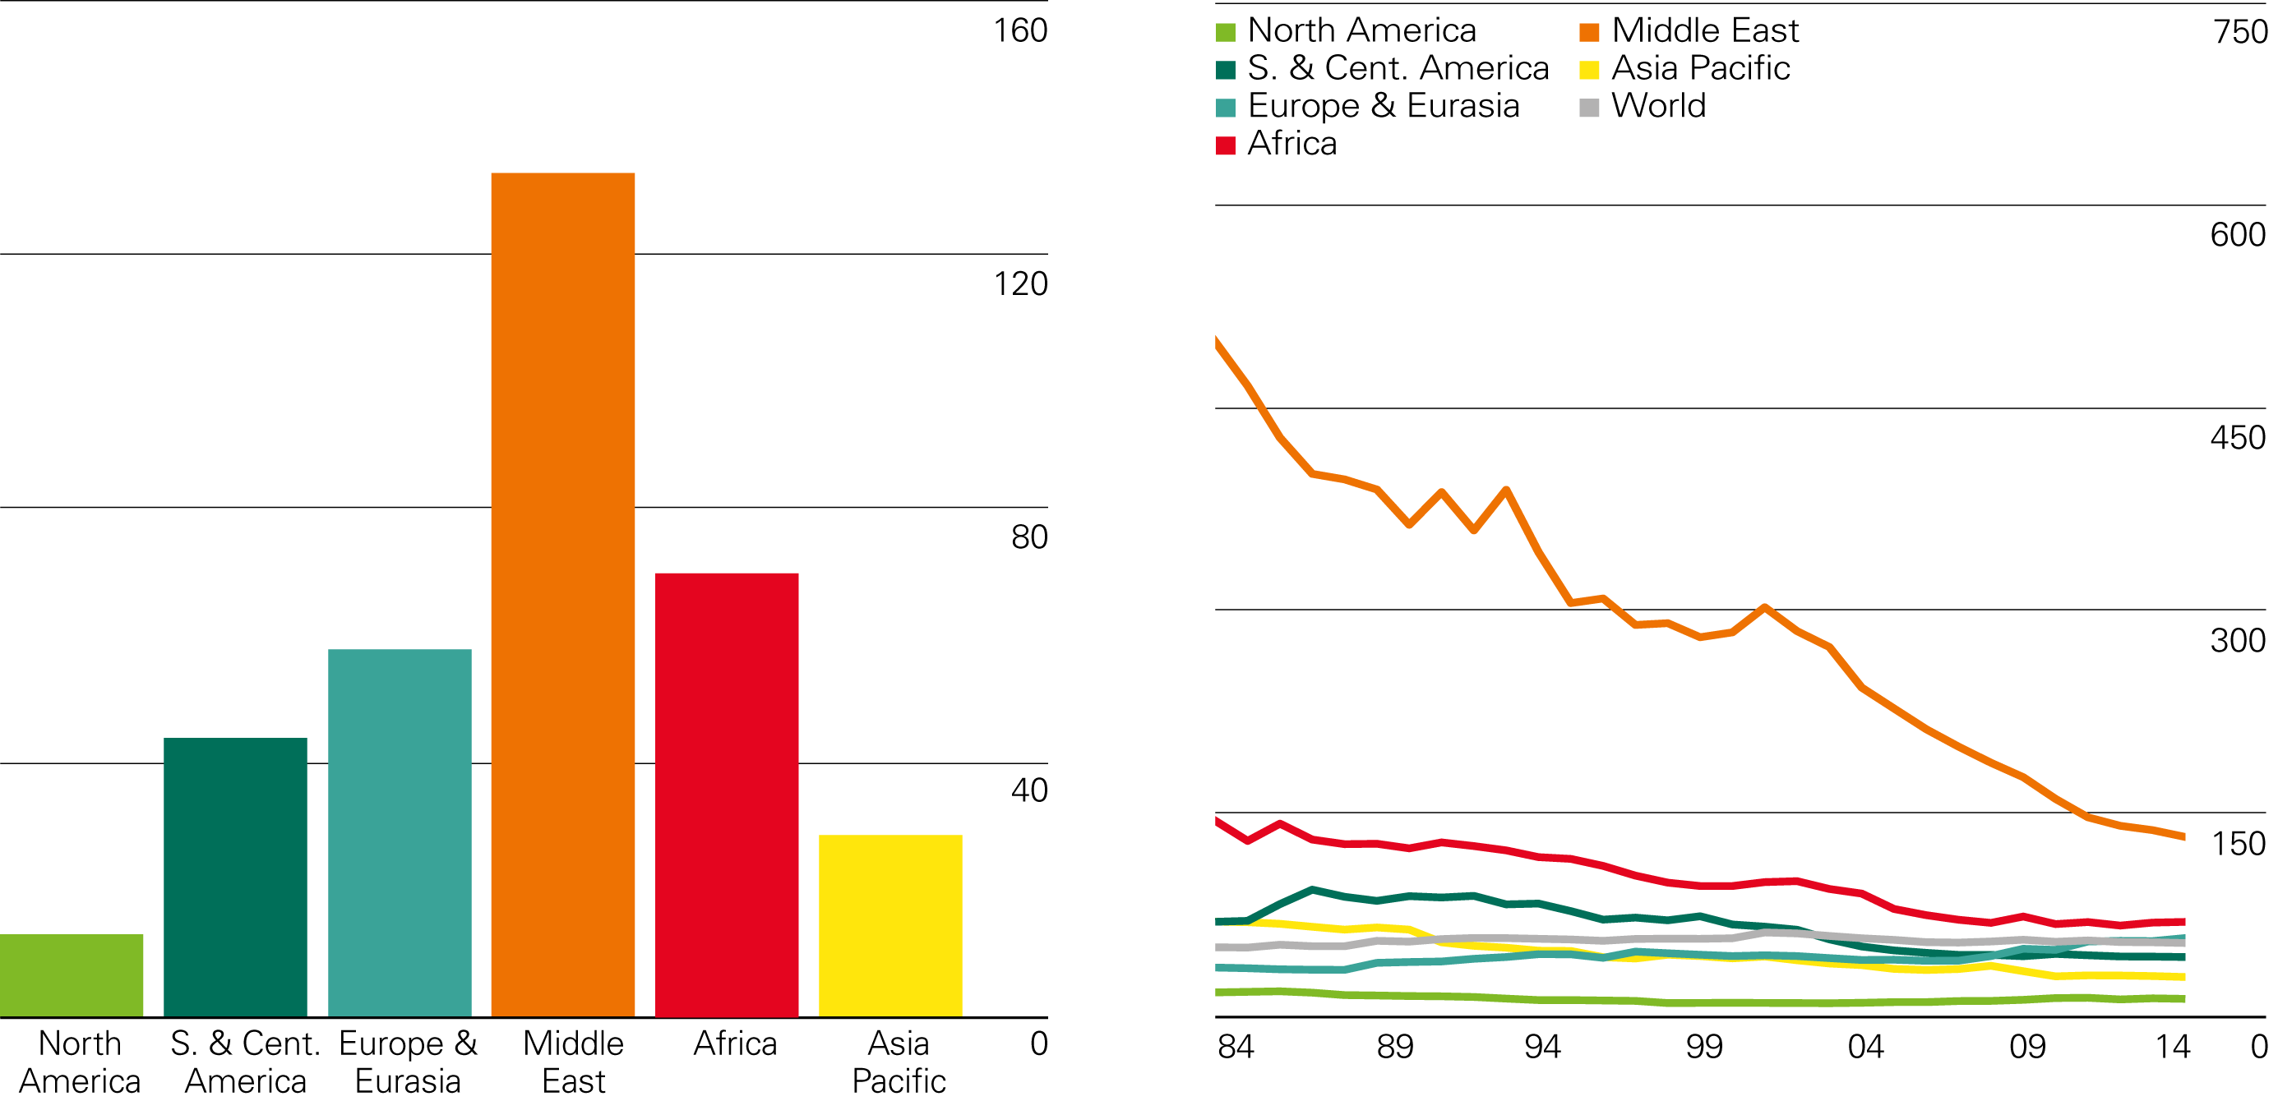
Gas reserves-to-production (R/P) ratios Years
2014 by region
History

Slide 8
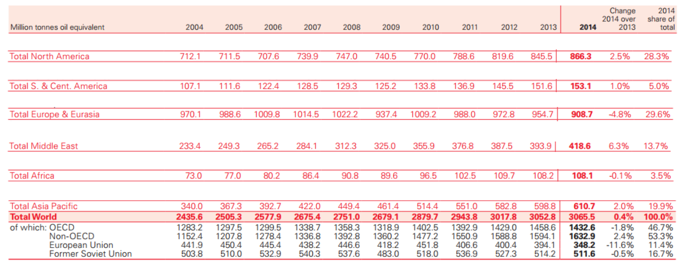
Consumption (consumo en ingles)

Slide 9
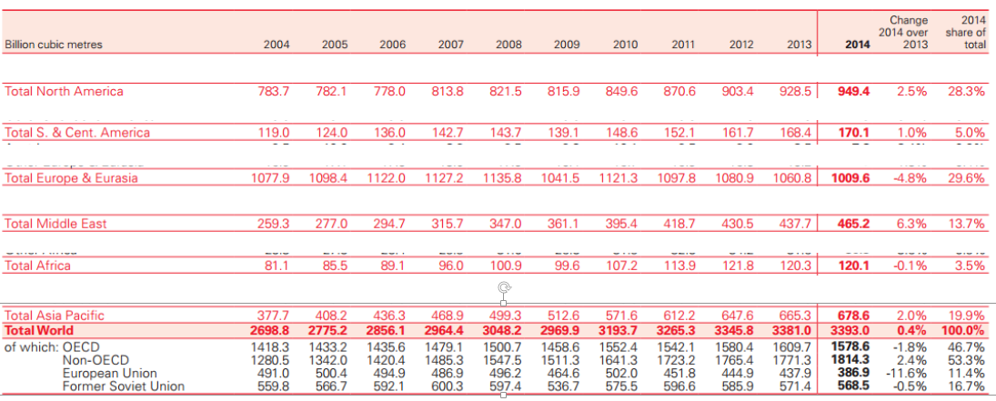
Consumption

Slide 10
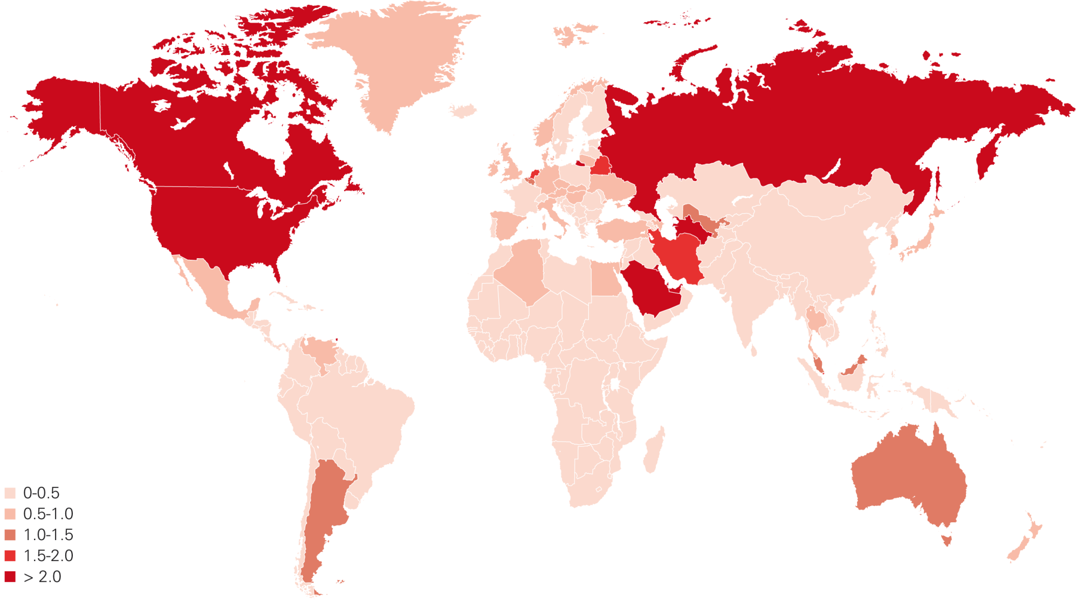
Gas consumption per capita 2014
Tonnes oil equivalent
Source: Includes data from Cedigaz.

Slide 11
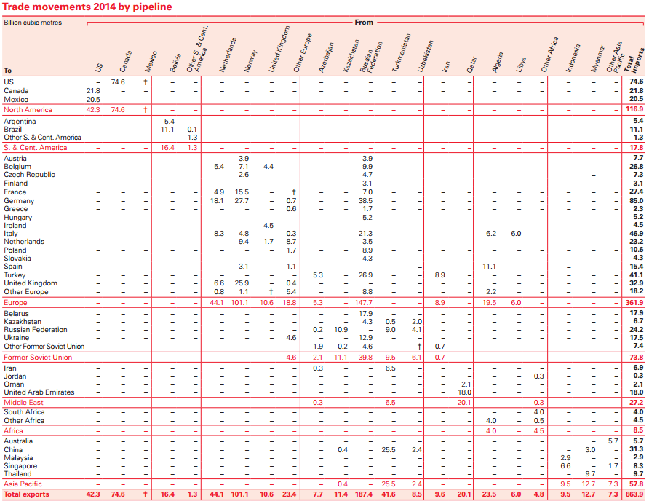

Slide 12
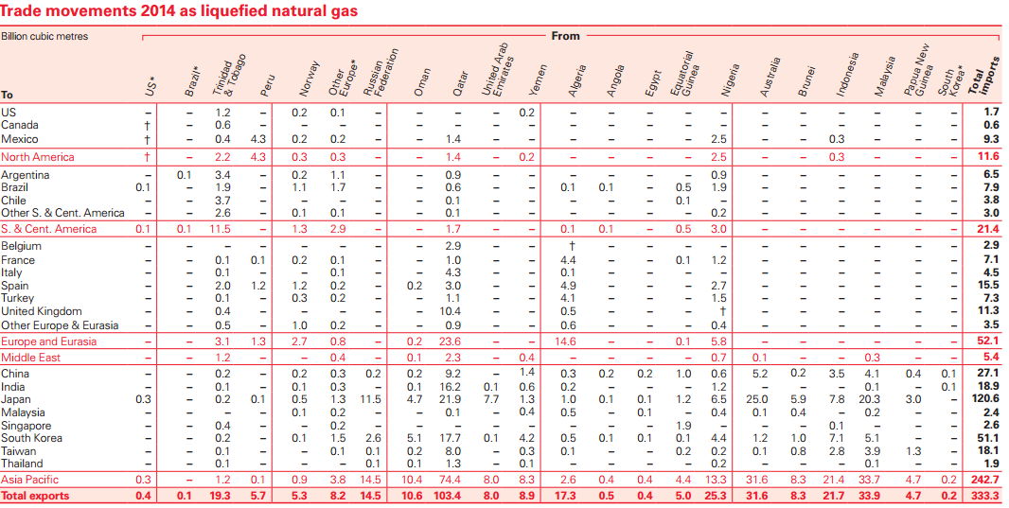

Slide 13
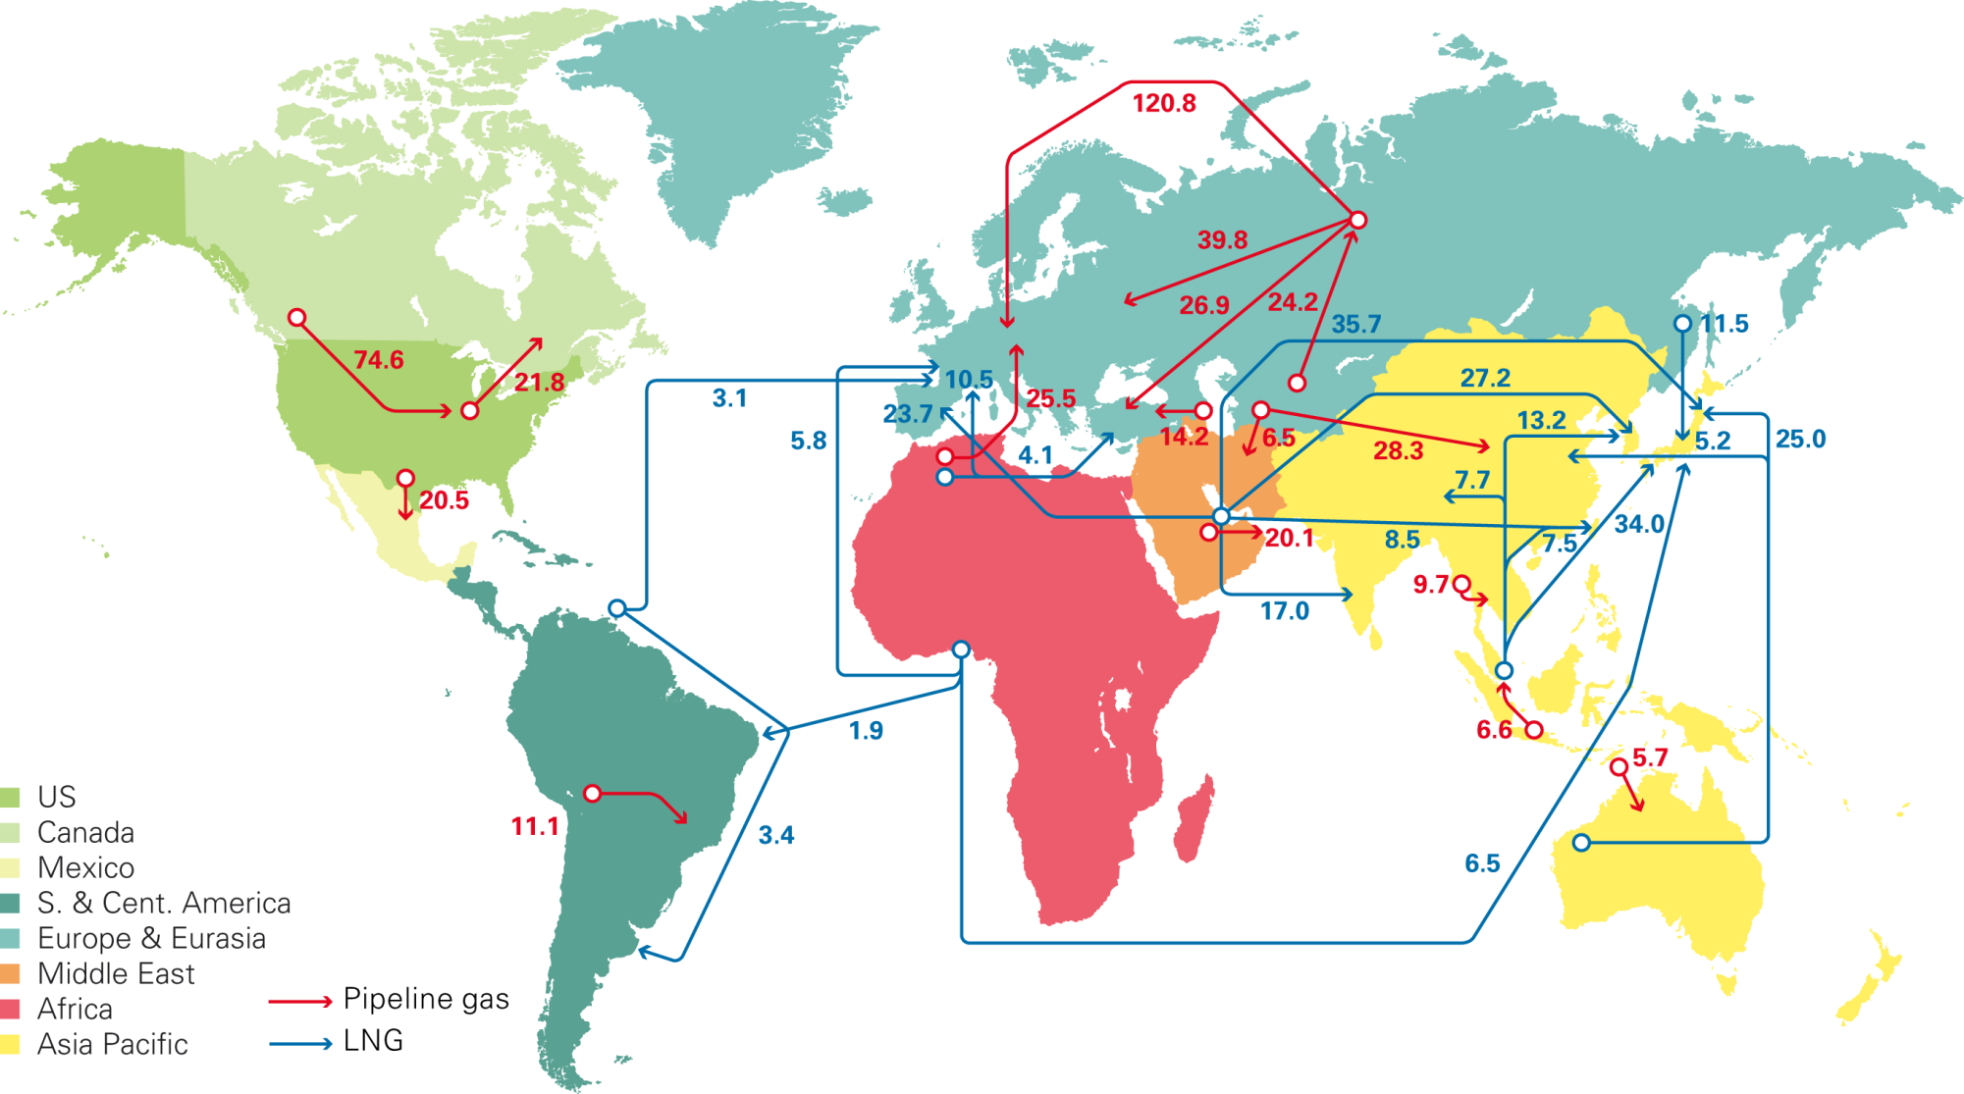
Major gas trade movements 2014
Trade flows worldwide (billion cubic metres)
Source: Includes data from Cedigaz, CISStat, FGE MENAgas Service, IHS CERA, PIRA Energy Group.

Slide 14
